Slide 1

Computational Thinking, Computer Science and Informatics CSCE100 | September 20, 2016
Professor Leen-Kiat Soh
Department of Computer Science and Engineering
University of Nebraska, Lincoln, NE
E-mail: lksoh@cse.unl.edu
http://img2.wikia.nocookie.net/__cb20130510160248/despicableme/images/e/e9/Despicable-Me-Minions_thumb10.jpg

Slide 2

Hmm ….
What is computational thinking?
http://www.picturescraze.com/movies/1528/despicable+me+minion.html

Slide 3
What is Computational Thinking?
A way of thinking for logically and methodically solving problems
E.g., purposeful, describable, replicable
Includes skills such as
Decomposition
Pattern Recognition
Abstraction
Generalization
Algorithm Design
Evaluation

Slide 4
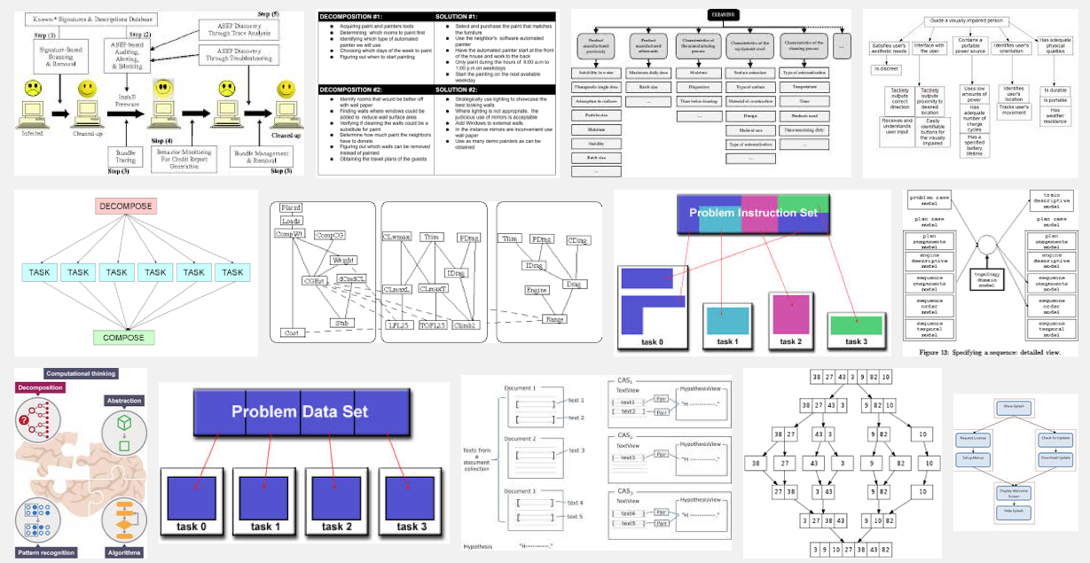
Decomposition
Breaking down a process into a set of smaller sub-processes to allow us to describe, understand, or execute the process better
Dividing a task into a sequence of subtasks
Identifying elements or parts of a complex system

Slide 5
Examples of Decomposition
When we taste an unfamiliar dish and identify several ingredients based on the flavor, we are decomposing that dish into its individual ingredients
When we give someone directions to our house, we are decomposing the process of getting from one place to another
When we break a course project into several steps, we are decomposing the task into smaller, more manageable subtasks
In programming, we can decompose a solution into multiple functions/modules/subroutines

Slide 6
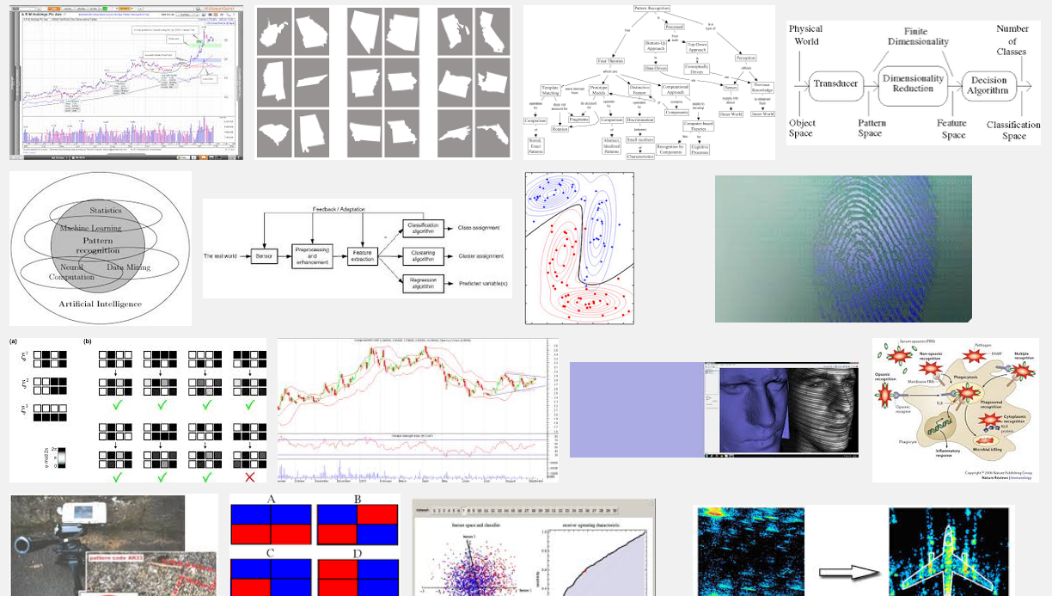
Pattern Recognition
Noticing or identifying similarities or common differences that will help us make predictions or lead us to shortcuts
We look for patterns when we play games to decide when to do certain things
Based on experience, we develop shortcuts mapping problem characteristics to solution

Slide 7
Examples of Pattern Recognition
We look for patterns when choosing a registrar when we checkout
Drivers look for patterns in traffic to decide whether and when to switch lanes
People look for patterns in stock prices to decide when to buy and sell
Scientists look for patterns in data to derive theories and models
We look for patterns and learn from them to avoid repeating the same mistake
“Last time we did this, it was … let’s try something different …”

Slide 8
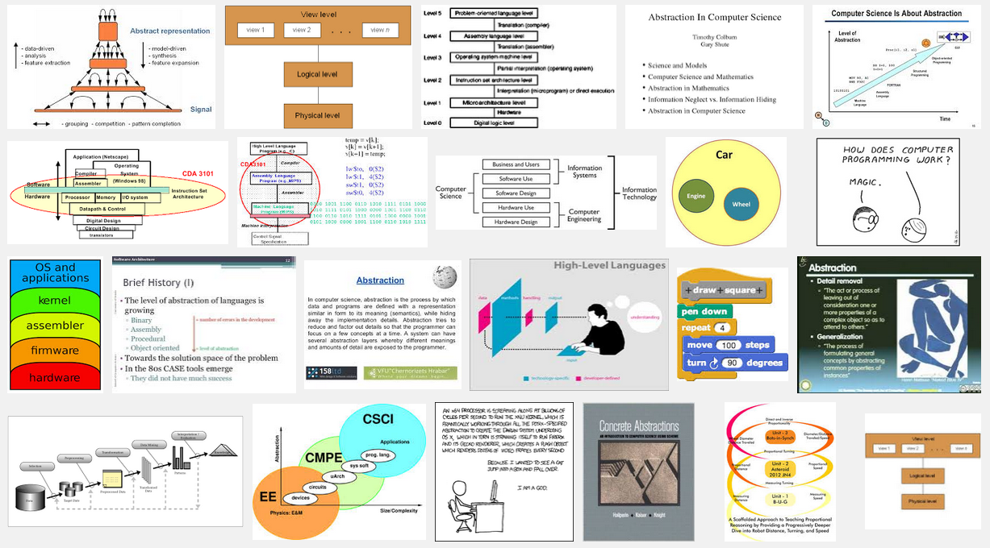
Abstraction
Preserving information that is relevant in a context, and forgetting or suppressing information that is irrelevant in that context to solve a problem
We use abstraction to organize things:
A human is a mammal, a mammal is an animal, and so on
A “big picture” so we can reason without thinking about the details
Guttag, John V. (2013-01-18). Introduction to Computation and Programming Using Python (Spring 2013 edition ed.). Cambridge, Massachusetts: The MIT Press. ISBN 9780262519632.

Slide 9
Examples of Abstraction
A world map is an abstraction of the earth in terms of longitude and latitude, helping us describe the location and geography of a place
A sign of an aisle in a store—e.g., Walmart—is an abstraction of the items available in that aisle
When we write a book report, we summarize and discuss only the theme or key aspects of the book, it is abstraction
When we tell a story or describe a movie to our friends, why don’t we describe every single detail of the story or movie?

Slide 10
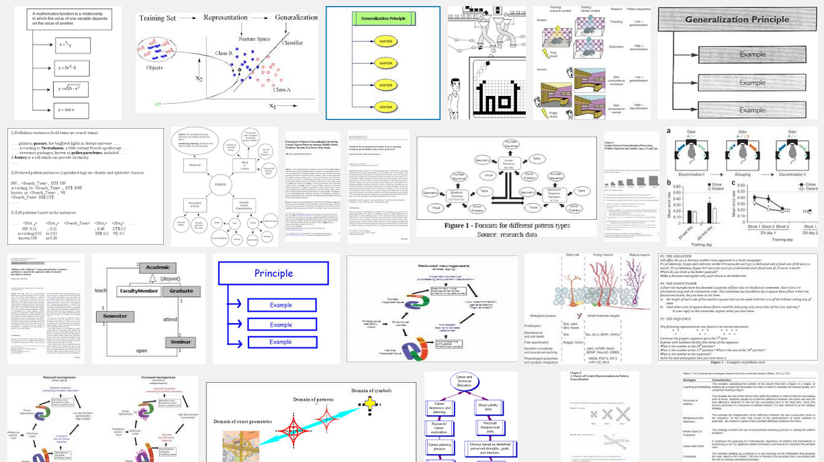
Generalization
Identifying common or shared characteristics between two domains or problems such that models or solutions of one could be adapted or applied to the other
Mammals are warm blooded, give live birth, have hair, and so on. An elephant is a mammal. Therefore, it is warm blooded, give live birth, have hair …
Group project A successful because of good teamwork strategy. Apply same good teamwork strategy to group project B should work too.
Deals with trends, norms, outliers, scalability

Slide 11
Examples of Generalization
Facebook suggests things of interest (e.g., ads) to you based on what you do on Facebook and what your friends do on Facebook
Google search identifies popular keywords in different regions at different times and suggests those keywords (in autocomplete and also correction) using a generalization-like process
Amazon.com and Netflix model and categorize their customers, use generalization—inferencing—to predict what their customers are interested in, and make recommendations accordingly
When we don’t have complete information, we resort to generalization to make decisions (sometimes incorrectly)
Think about: biases, stereotypes, superstitions

Slide 12
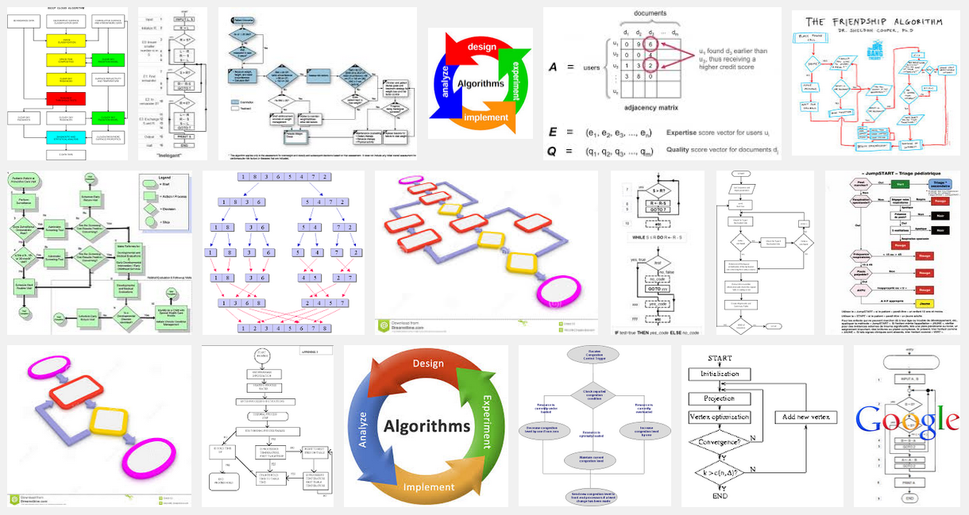
Algorithm Design
Developing a step-by-step strategy for solving a problem
An algorithm is a sequence of steps that solves a problem
Input → output
Effective
Algorithmic thinking involves both creation and execution of an algorithm

Slide 13
Examples of Algorithm Design
When a cook writes a recipe for a dish, he or she is creating an algorithm that others can follow to replicate the dish
When your friend writes down the instruction to get to her house, he or she is specifying a sequence of steps—that is, an algorithm—for you to follow (See Google maps!)
When a teacher gives a set of instructions to carry out an experiment, he or she is specifying an algorithm for you to follow to collect and analyze data
When you solve a Sudoku puzzle, you follow a sequence of looking at constraints and possible options, and making tentative guesses, and revising your entries …

Slide 14
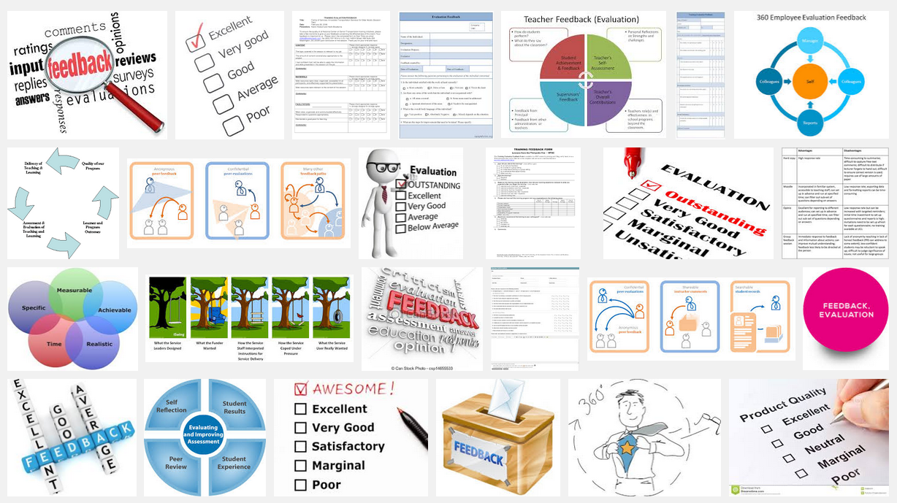
Evaluation
Checking to see whether a solution is good
Algorithm correctness
Requirements (meeting constraints, design principles, etc.)
Performance (usability, efficiency, speed, complexity, reliability, etc.)

Slide 15
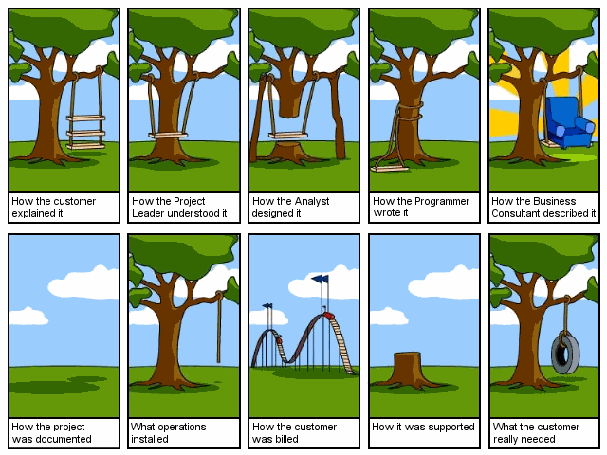
https://medium.com/@FreeCodeCamp/coding-explained-in-25-profound-comics-8847ea03819c

Slide 16
Examples of Evaluation
When we cook, we taste our dishes and then adjust flavoring accordingly
When we fold a paper airplane, we test its flight, and then revise either the design or the “execution” to make it fly better
When we jog or bike, we keep track of our breathing, joints, etc., and decide whether to stop, go slower, or go faster
When we carry out a physics experiment, say, to find the relationship between temperature and pressure, we check our data, investigate why it does not match the theory, redo our experimental setup, and recollect data points …

Slide 17

So, Computational Thinking is …
Wait a minute … These are things that we already are capable of doing!!!
Decomposition
Pattern Recognition
Abstraction
Generalization
Algorithm Design
Evaluation
http://www.wallpapersax.com/wallpaper/cartoons-despicable-me-minion.html

Slide 18
Assignment
Check Canvas. You have been assigned to a group.
In your groups, refer to the assignment Everyday Object.
It might not feel like it, but this is our first steps in learning programming.
You’re going to describe functions required to make something work.

